Slide 1
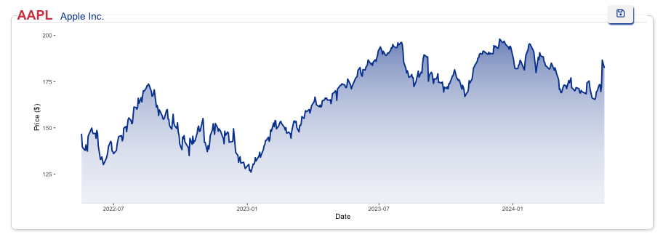
Unveiling the Secrets of Stock Market with R & Rshiny
Loan K Robinson Nov 16th, 2024

Slide 2
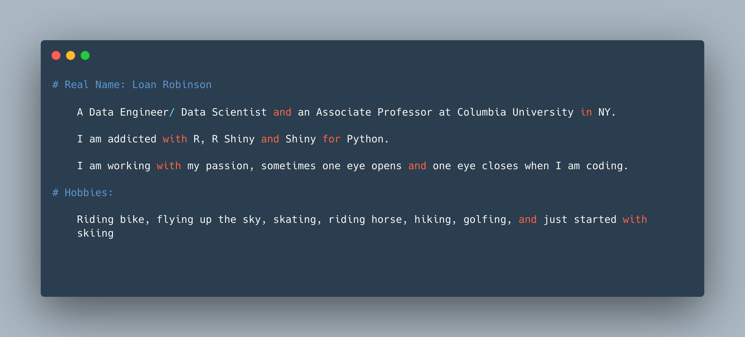

Who I am?

Slide 3

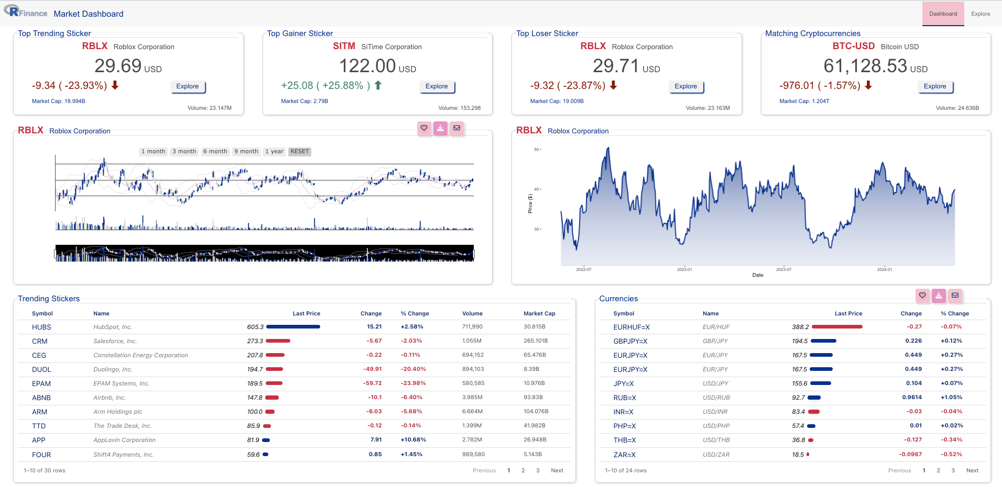


RShiny App Structure
Server (Backend)
Client (User Interface)
Local Machine
Cloud (shinyapps.io)

Slide 4
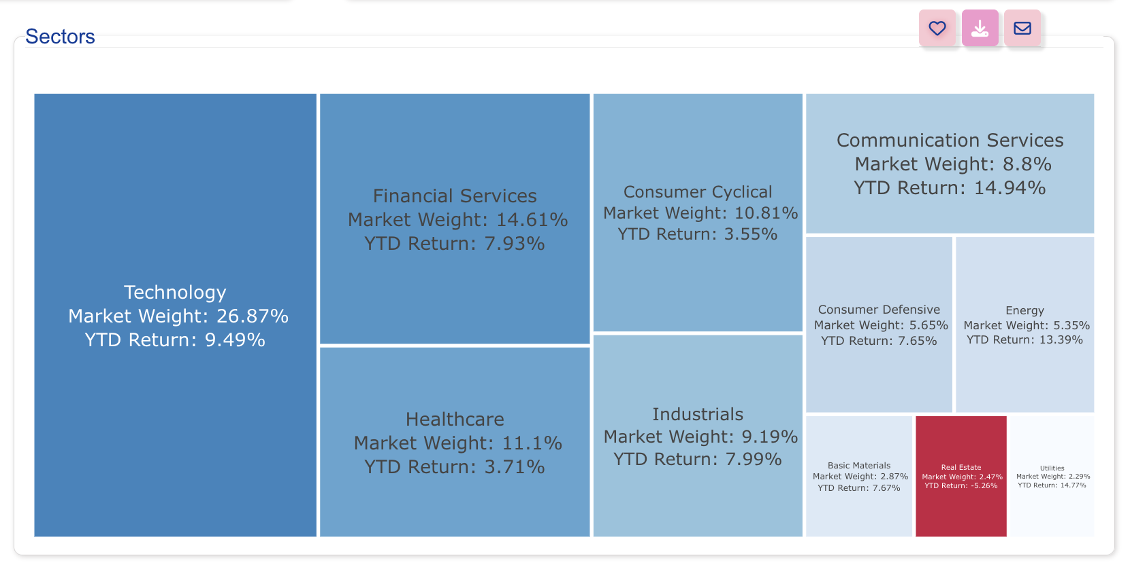
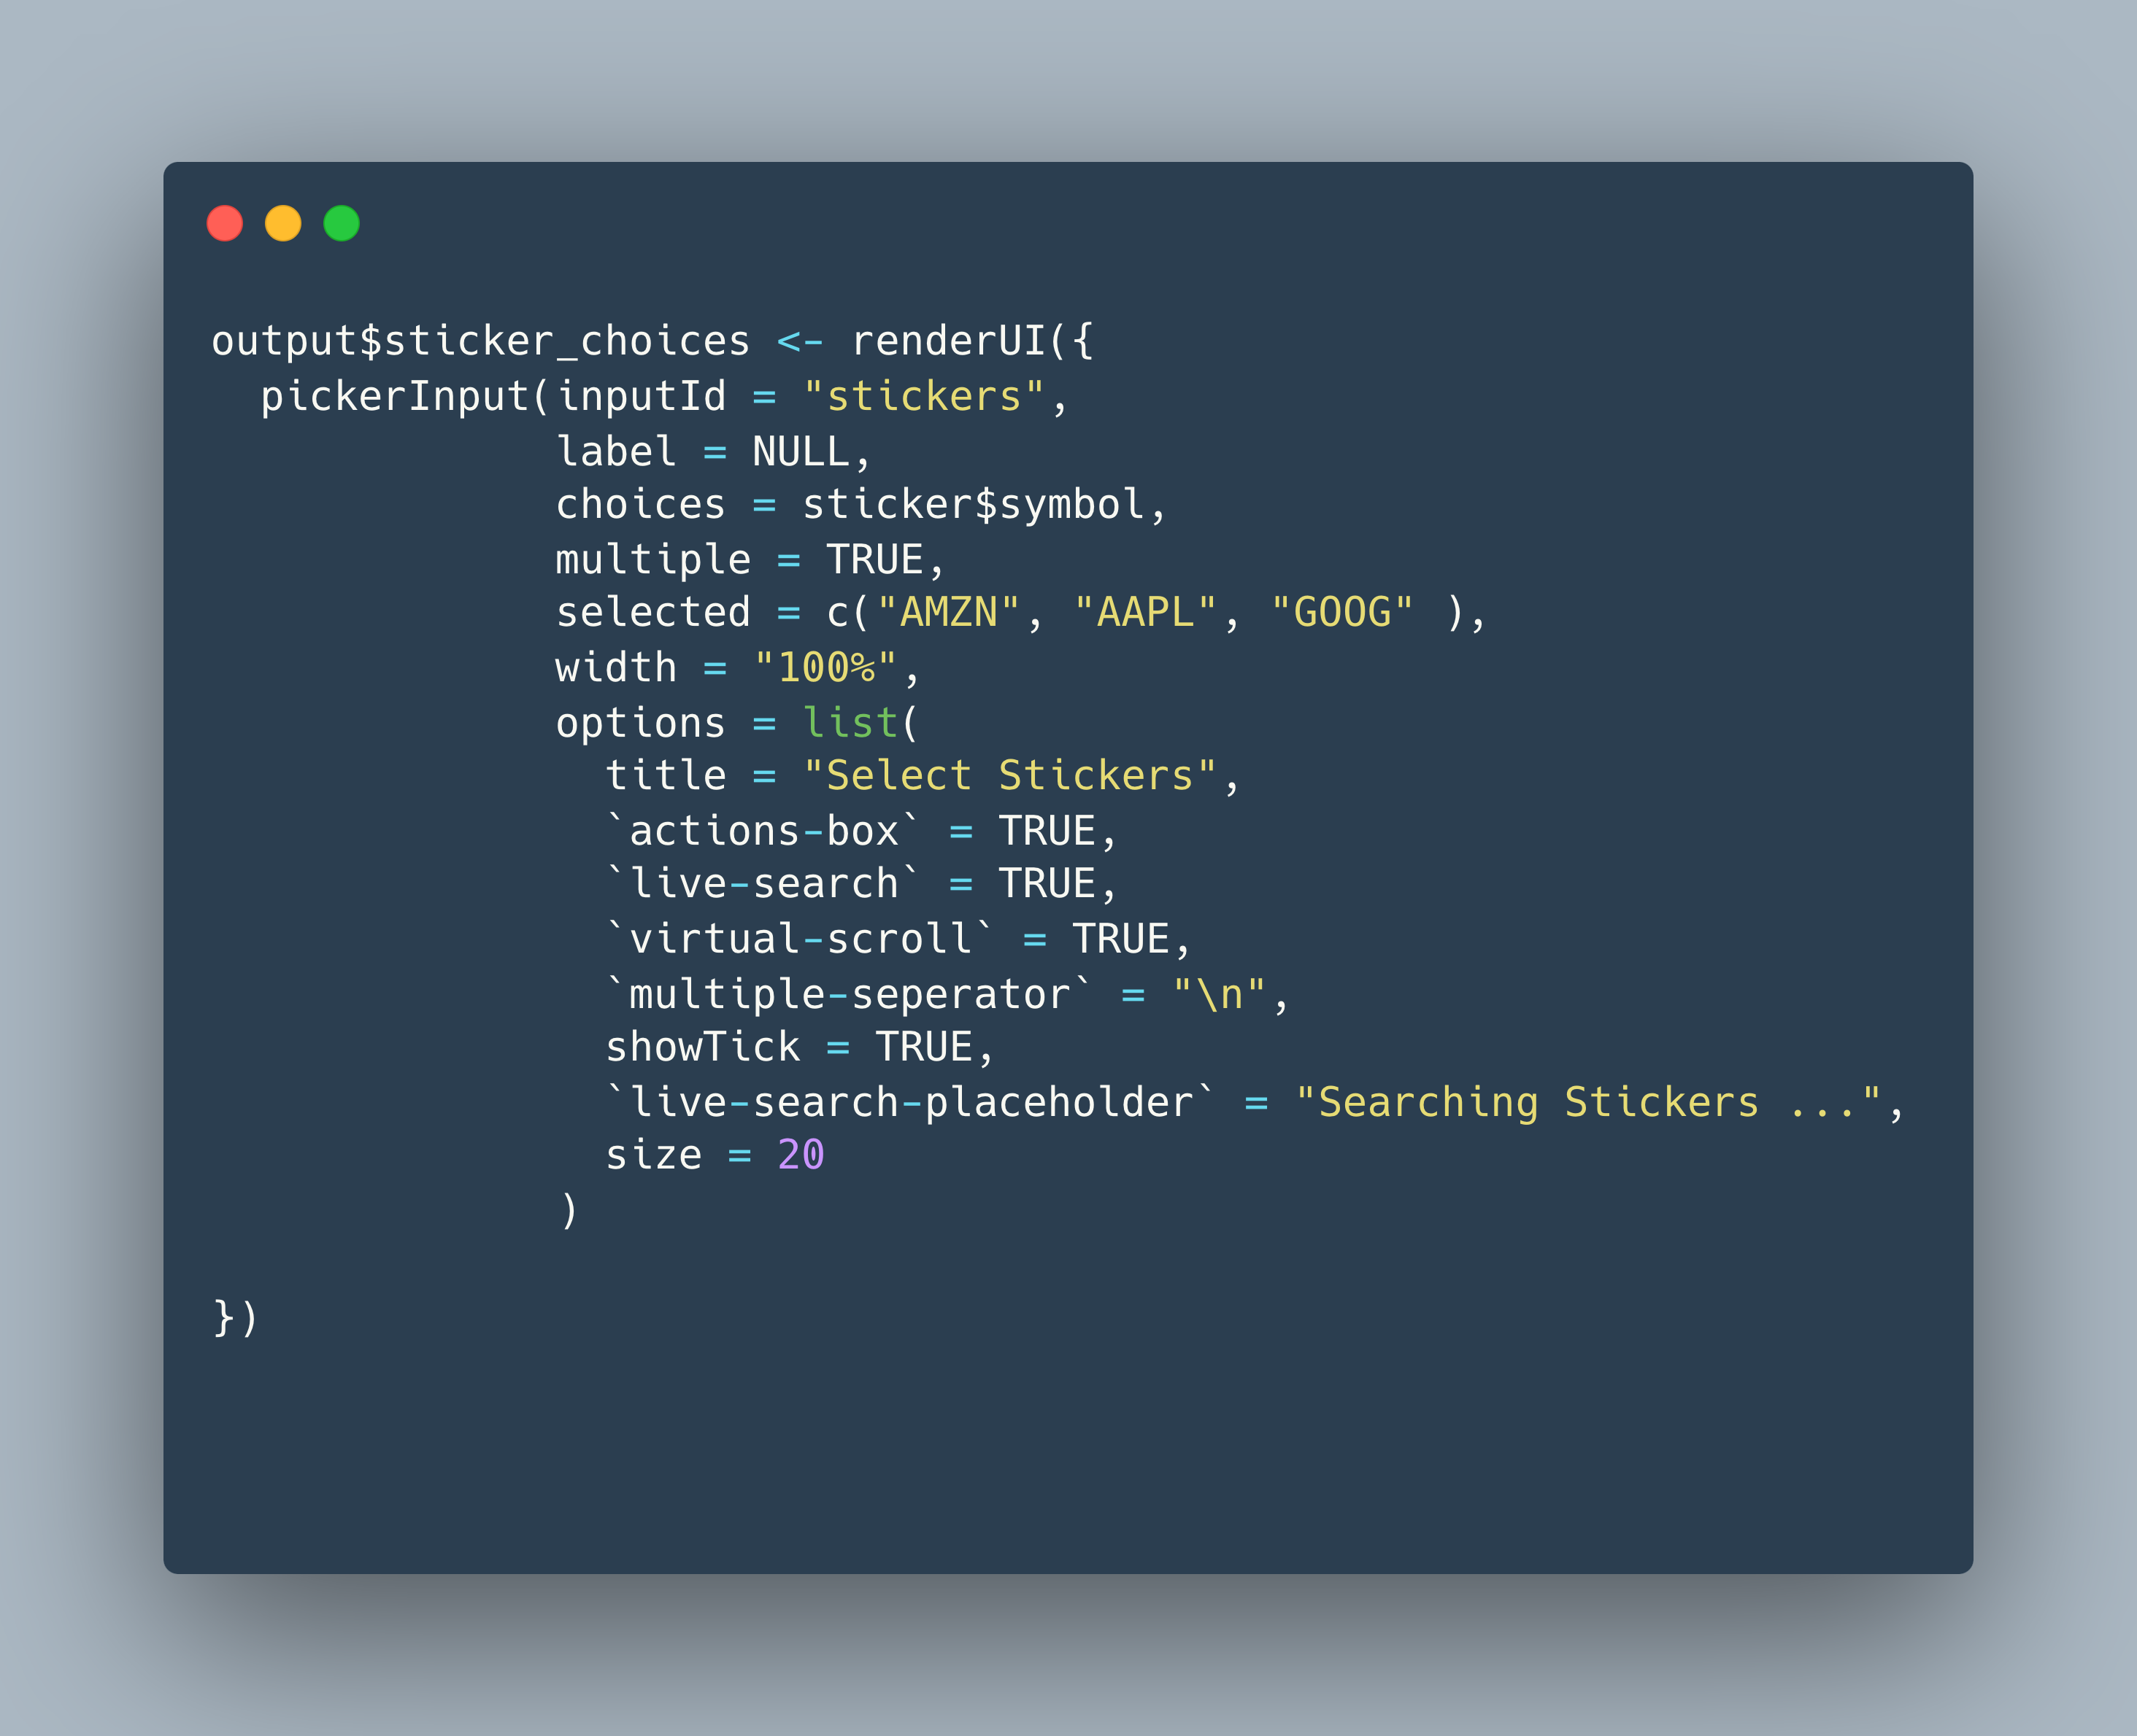
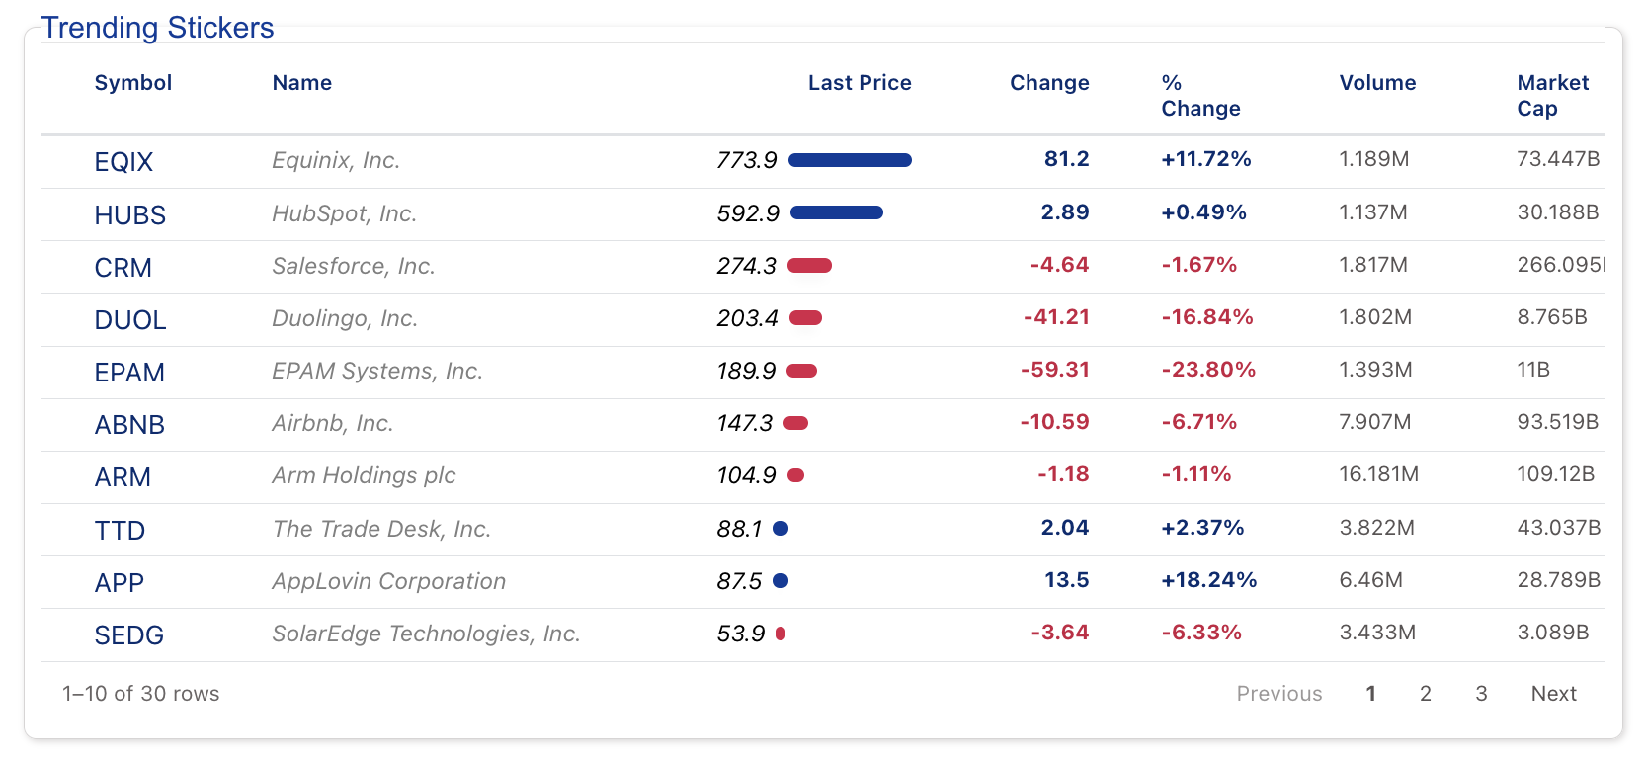
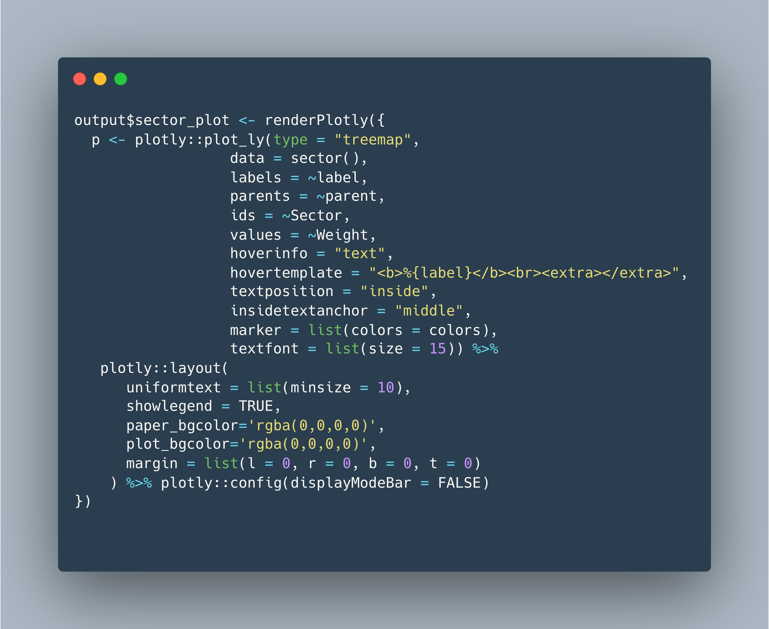
R Shiny App
ui
pickerInput()
dateInput()
Outputs
Inputs
server
renderPlotly()
renderReactable()

Slide 5
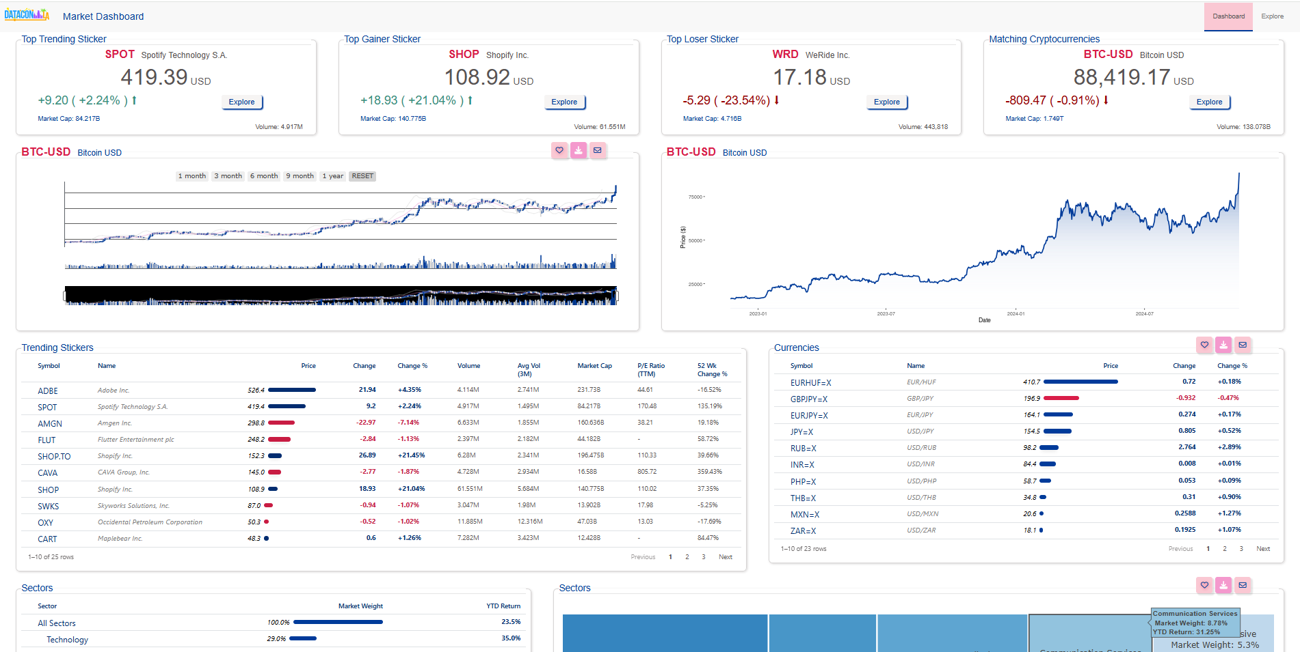
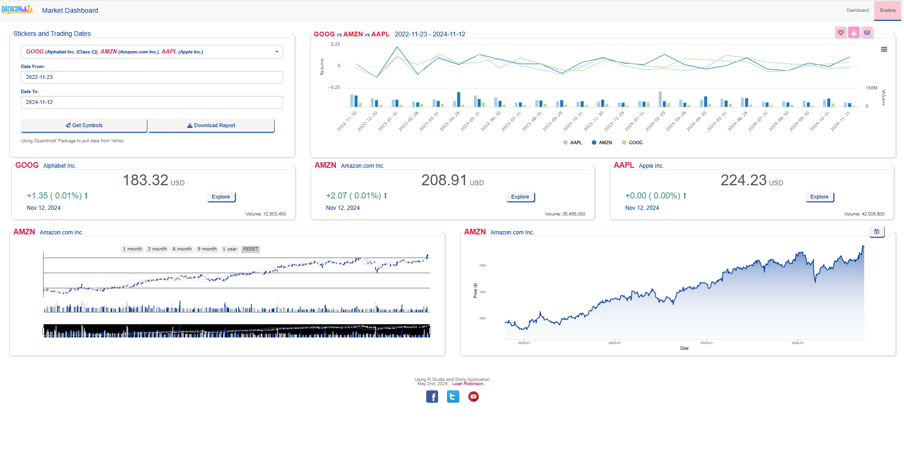
Front End UI
Look Prettier !
style.css
navbarPage…
Shiny layout
Important !!!
Colors, Texts
Heart of the app
Charts, Tables
Inputs
Stickers input
Date from – Date to
Action buttons

Slide 6

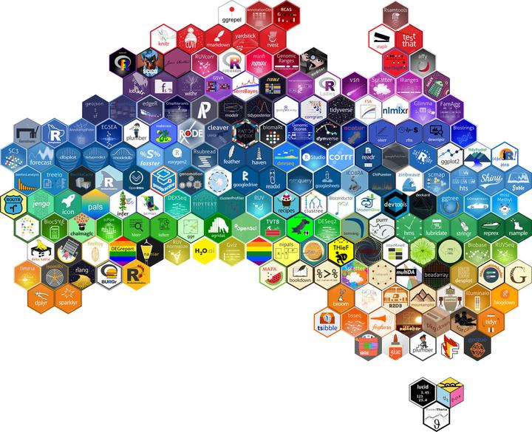
Back End Server
Data Source
Yahoo Website to pull data
https://finance.yahoo.com/trending-tickers
R Functions (they talk to each other)
Using `quantmod` package to get the stock prices
global.R
footer.R
global.R
footer.R
ui.R
losers.R
Sticker Names stored in data directory
ui.R
losers.R
server.R
trending.R
server.R
trending.R
crypto.R
all_line_plot.R
crypto.R
all_line_plot.R
gainers.R
dashboard_table.R
gainers.R
dashboard_table.R
inputs.R
explore_stickers.R
YOUR SHINY APP WILL BE
HERE
inputs.R
explore_stickers.R
explore_trending_stickers.R
R Libraries
download_md.R
explore_trending_stickers.R
www folder
logo
style.css

Slide 7
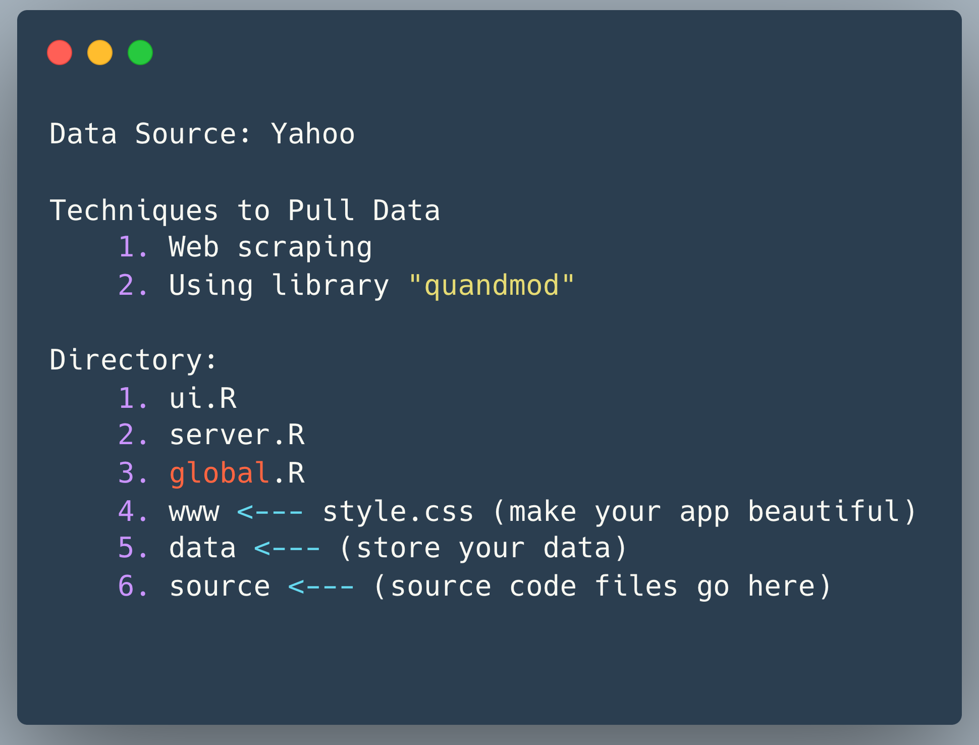
Market Dashboard Components

Slide 8
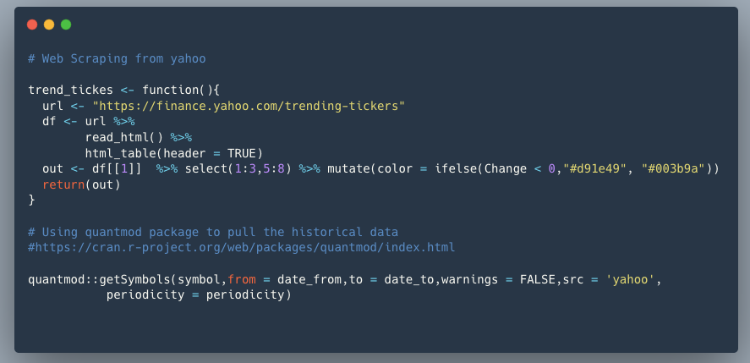
Web Scraping and Quantmod package

Slide 9
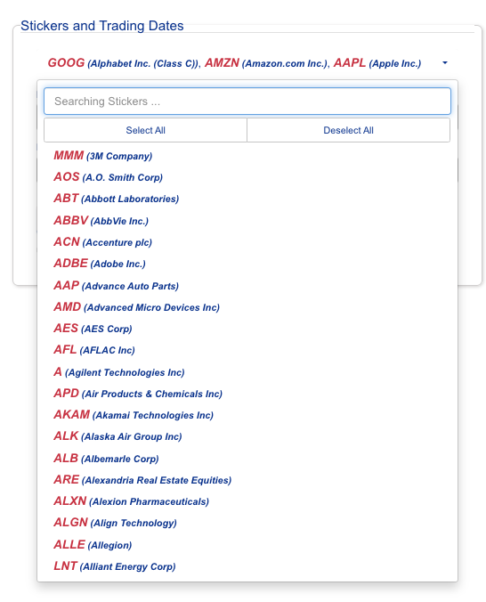
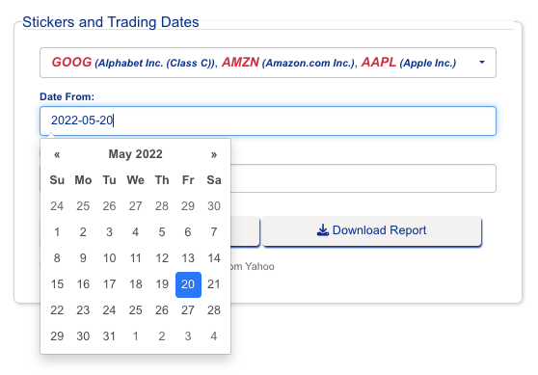
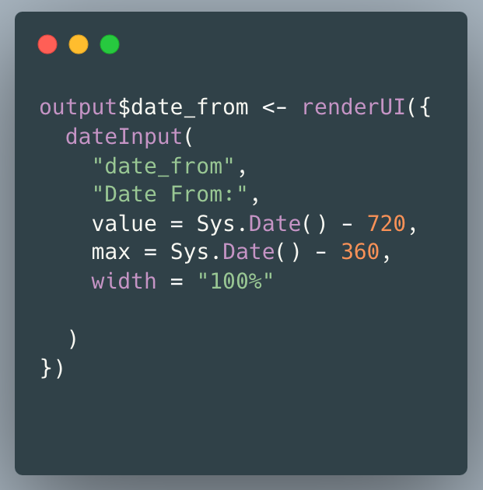
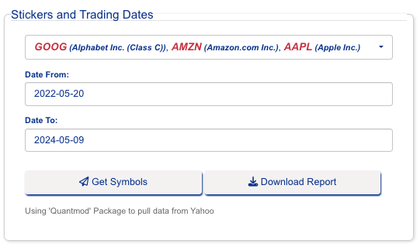
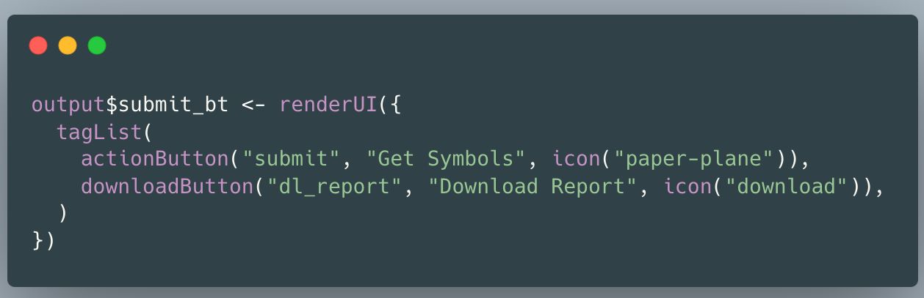
Inputs
1. Stickers
2. Date From – Date To
3. Get Symbols Button

Slide 10
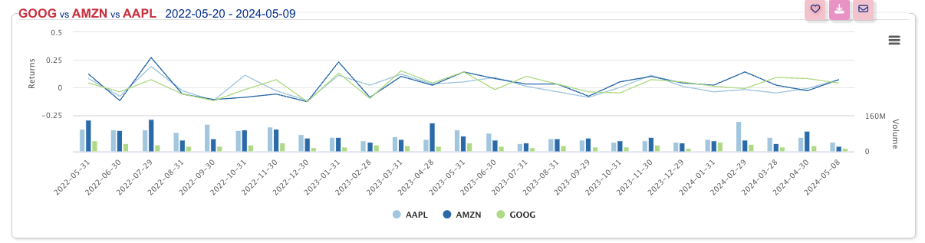
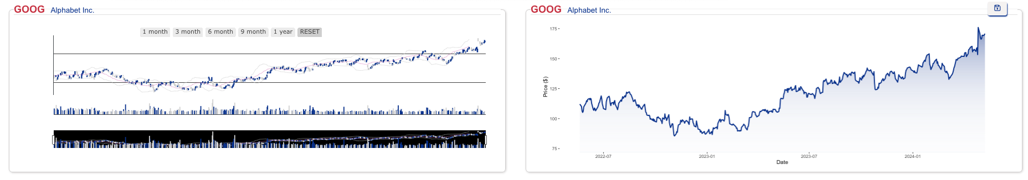
Outputs
Inputs
1. Stickers
2. Date From – Date To
3. Get Symbols Button
Inputs
Explore button

Slide 11
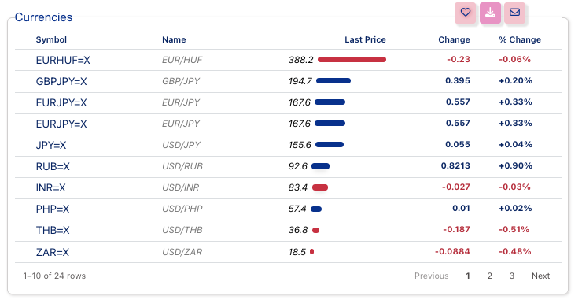
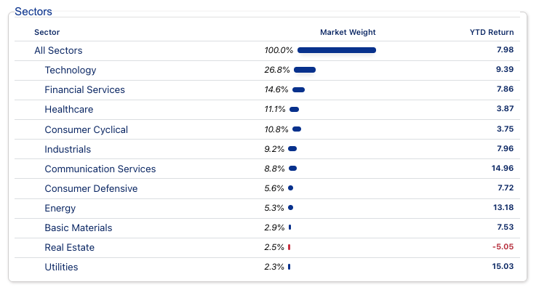
reactable and reactablefmtr Tables
https://kcuilla.github.io/reactablefmtr
https://glin.github.io/reactable

Slide 12
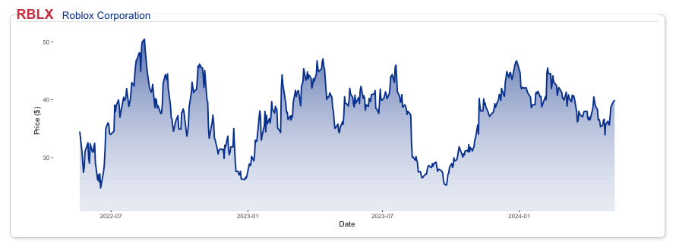
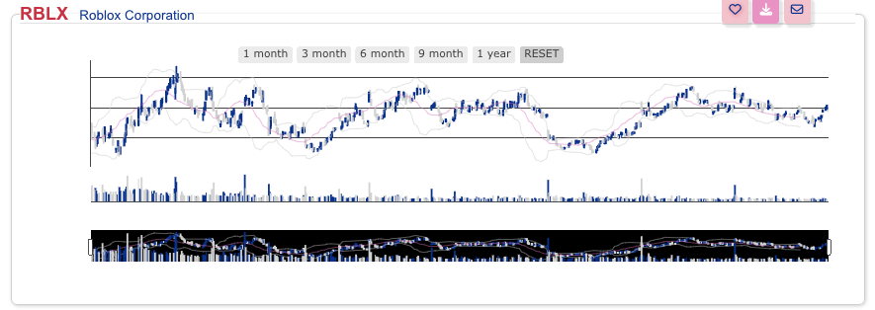
Figure Outputs
Ggplot2 package
plotly package

Slide 13
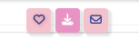
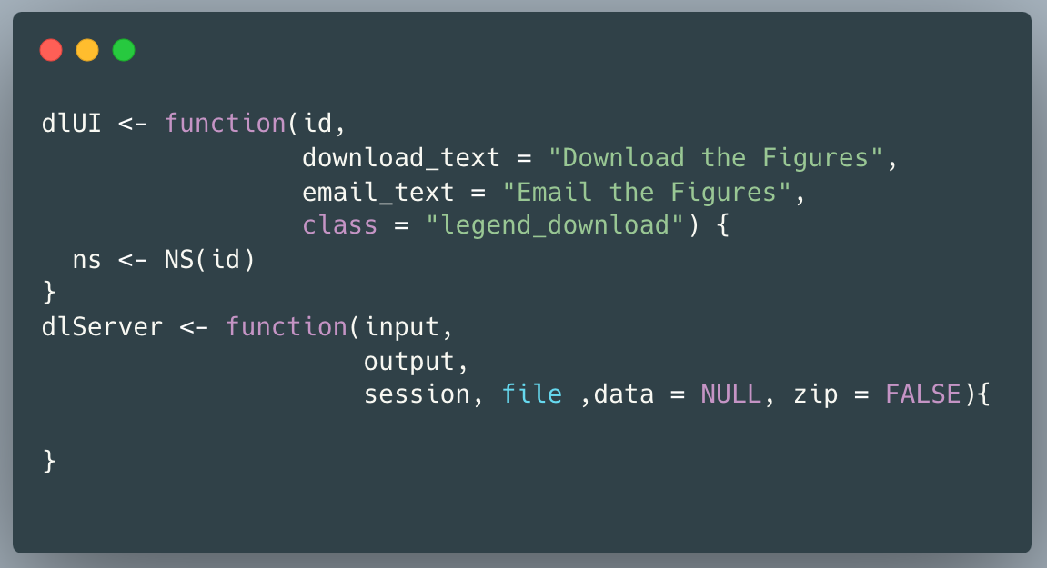
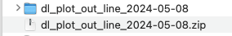
R Shiny Modules
Add to your favorite list
Download the zip file with figure and table
Send the figure and table to email

Slide 14
Questions ?
App: https://loanrobinsonscientist.shinyapps.io/stock_dashboard_app_final/
Codes Available: https://github.com/loankimrobinson/stock_market_conference
Questions to: loankimrobinson@gmail.com
Thank you for attending

